Slide 1

Working in the Shadows for Transparency: Russ Hiebert, LabourWatch, Nanos Research, and the Making of Bill C-377
Dr. Andrew Stevens
Dr. Sean Tucker
Faculty of Business Administration
University of Regina
Wednesday, October 8, 2014

Slide 2
Acknowledgements
Thank you to all of our interviewees and Bill Bonner, Shelagh Campbell, Kelly Miner, Hugh Wagner, Phil Johnson, and Devon Anderson for feedback on the research. We also appreciate the support from Jen Richards and Jessica Wood at all stages of this project and Kelly-Ann McLeod for organizing this presentation and a previous presentation in 2012.
An earlier version of this research was presented at the 2014 Canadian Industrial Relations Association Conference at Brock University.

Slide 3
Studying C-377
Political economy of anti-unionism and Canada’s polling industry
Bill C-377: Not a flash in the pan but a “long con”
Federal Access to Information requests: Government transparency or endless road blocks?
Wealth of key informant interviews
Hansard records and the media resource

Slide 4
Overview of Presentation
The letter of C-377
The US Model
Laying the ground work for C-377: Generating public support through polling
A long legislative journey begins
Polling and public policy
Professionalism and polling
Senators strike back
The return of C-377
Future of anti-unionism
Improving public opinion polling

Slide 5
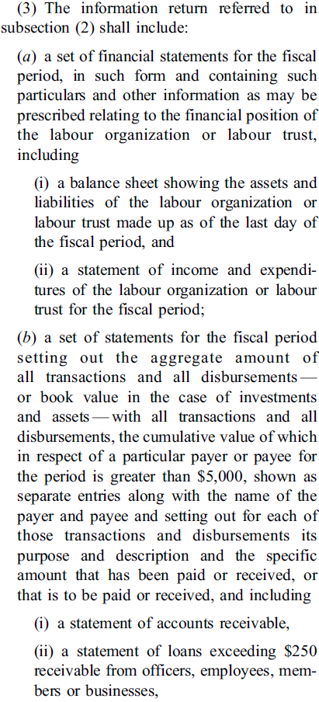
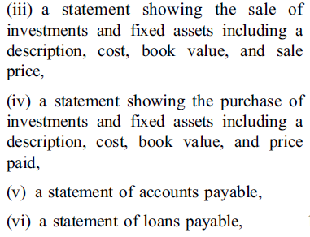
Private Member’s Bill C-377
Balance sheet, income statement
Identify all transactions over $5,000 with name of payer & payee, address, and description of transaction
Statements of loans, assets, and investments

Slide 6
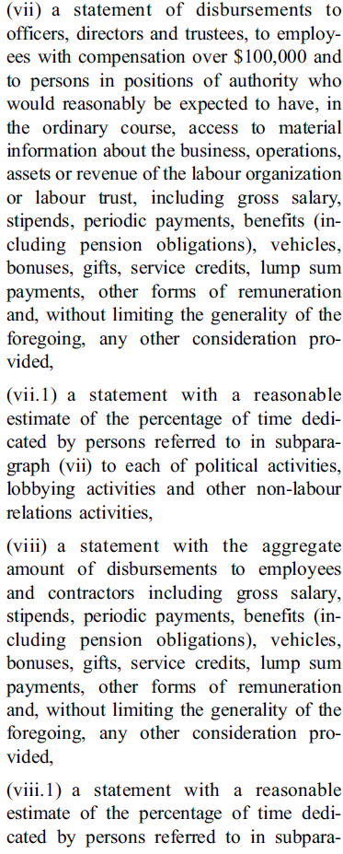
Private Member’s Bill C-377
Salaries of officers and directors. Percentage of time dedicated to political and lobbying activities
Salaries of employees and contractors. Percentage of time dedicated to political and lobbying activities

Slide 7
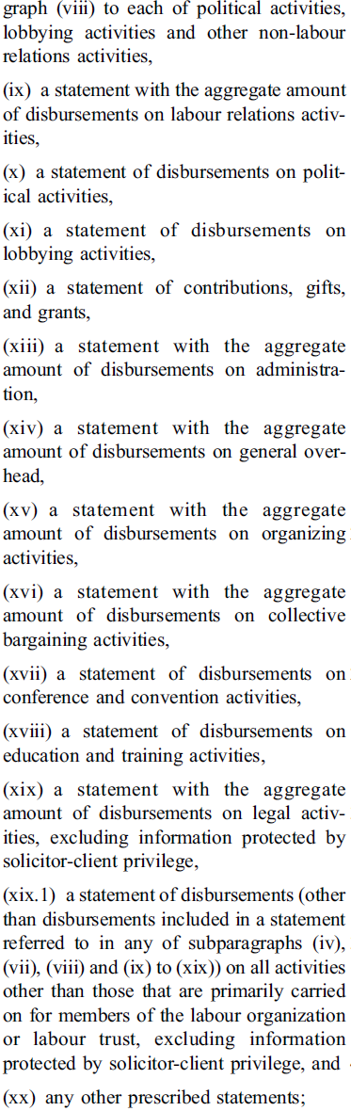
Private Member’s Bill C-377
Labour relations, political, lobbying, gifts, grants, administration, overhead, organizing, bargaining, conference, convention, education, training, and legal.

Slide 8

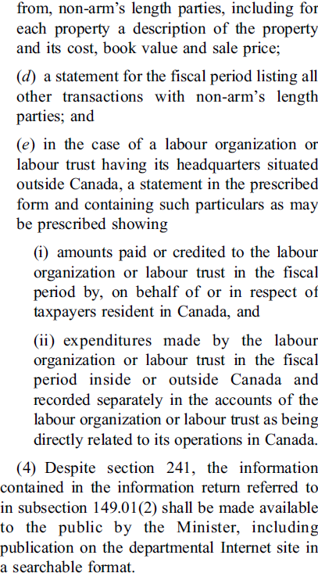
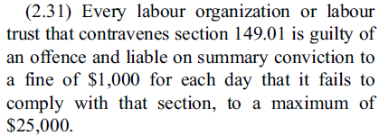
Private Member’s Bill C-377

Slide 9
Hiebert’s Model for Transparency
A reporter notes “Hiebert said he finds it ironic that one can find more information on spending by Canadian labour organizations that are affiliated with U.S. unions on the U.S. Labour Department’s website than can be had from any source in Canada.” Said Hiebert, “That exact issue is what got me interested in this a couple of years ago.”
- Browne, A. “Hiebert raps ‘illegal’ union donations,” Peach Arch News, 6 November 2012.

Slide 10
Hiebert’s Model for Transparency
Hiebert explains that C-377 is “mirrored on American legislation” and “levels the playing field” for unions operating in both Canada and the United States.
Hansard, Proceedings of the Standing Senate Committee on Banking, Trade and Commerce. 2013, May 22, 34.

Slide 11
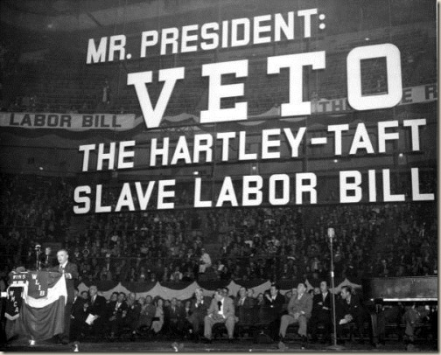
The US Model for Union Financial Disclosure
The “Fish Bowl” effect
Union disclosure as an extension of labour policy
Four phases of union disclosure legislation in the U.S.
  Taft-Hartley (1947)
  Labor-Management Reporting and Disclosure Act, Landrum-Griffin Act (1959)
  Politicized reporting standards throughout the 1990s
  Bush Administration (2002)

Slide 12
The US Model for Union Financial Disclosure
1959: “I would object… to a corporation being compelled to give every shareholder a list of all its customers and the prices it is quoting and all the letters of information it receives on any matter in any of the books of the corporation.” Senator John F. Kennedy
1992: House Republican Whip, Newt Gingrich, on proposed changes to reporting standards would “weaken our opponents and encourage our allies”.
Grover Norquist (Alliance for Worker Freedom) “We’re going to crush labor as a political entity” […] and “break unions”
  Every dollar spent on lawyers, accountants, clerks, etc. was a dollar not spent on organizing, political activities, and member representation.

Slide 13
Bill C-377 Timeline
  October 3, 2011: Russ Hiebert introduces Bill C-317 “An Act to amend the Income Tax Act” (Speaker rules C-317 out of order)
  December 5, 2011: Bill C-377 (first reading)
  December 12, 2012: Bill C-377 passes Commons, heads to the Senate
  June 26, 2013: Senate sends Bill C-377 back to the Commons with amendments
  October 16, 2013: Commons returns original Bill C-377 to the Senate
  September 25, 2014: Bill C-377, renewed interest at Second Reading

Slide 14
Bill C-377 Actors
Russ Hiebert, Member of Parliament
John Mortimer, President, LabourWatch
Terrance Oakey, President, MERIT Canada
Hugh Segal, Former Conservative Senator
Ken Georgetti, Former CLC President

Slide 15
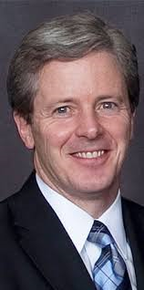
Laying the Ground Work for C-377:
Labour Watch and Public Opinion Polling
The Canadian LabourWatch Association formed in 2000 as a coalition of employer associations, namely Restaurants Canada (then the Canadian Restaurant and Foodservices Association), the Canadian Federation of Independent Businesses (CFIB), Retail Council of Canada, and the Merit Contractors Association of Alberta.
John Mortimer, President
Sponsored four “Labour Day” polls between 2003 and 2013
Before Oct. 2011 | Oct. to Nov. 2011 | Dec. 2011 to Dec. 2012 | Dec. 2012 to June 2013 | June 2013 to Present

Slide 16
Laying the Ground Work for C-377:
Labour Watch and Public Opinion Polling
Issues in LabourWatch polling ...
Op-out of union dues
Political contributions
Right to work
Public disclosure of information
Before Oct. 2011 | Oct. to Nov. 2011 | Dec. 2011 to Dec. 2012 | Dec. 2012 to June 2013 | June 2013 to Present

Slide 17
Laying the Ground Work for C-377:
Labour Watch and Public Opinion Polling
LW-sponsored polls conducted in 2003, 2008, 2011, and 2013 have asked questions about public disclosure of union spending.
“83% of Canadians agreed with mandatory public financial disclosure for both public and private sector unions on a regular basis.” (July 2011 poll)
- State of the Unions 2011 - LabourWatch – August 2011
Before Oct. 2011 | Oct. to Nov. 2011 | Dec. 2011 to Dec. 2012 | Dec. 2012 to June 2013 | June 2013 to Present

Slide 18
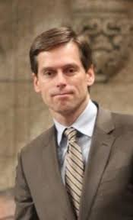
The Opening Act: C-317
- MP Russ Hiebert introduces Bill C-317, An Act to Amend the Income Tax Act.
“The bill would require a public disclosure
of the finances of labour unions. This is in
line with the increased transparency we have
introduced for government departments,
agencies and native reserves. Public disclosure
is strongly supported by the Canadian public
and even more so by union members
themselves.” (Hiebert, October 3, 2011)
Before Oct. 2011 | Oct. to Nov. 2011 | Dec. 2011 to Dec. 2012 | Dec. 2012 to June 2013 | June 2013 to Present

Slide 19
Support for C-317
“Your bill is particularly timely, in fact, given that a recent Nanos Research poll found that 83 per cent of working Canadians believe that the law should require both public and private sector unions to be financially transparent with the public.”
- Canadian Federation of Independent Businesses. October 19, 2011
Before Oct. 2011 | Oct. to Nov. 2011 | Dec. 2011 to Dec. 2012 | Dec. 2012 to June 2013 | June 2013 to Present

Slide 20
C-317 Ruled Out of Order
C-317 included a provision that would have revoked the tax exempt status of a labour organization, in accordance with Section 149(1)(k) of the Income Tax Act, should that organization fail to provide sufficient financial information.
Bill was ultimately ruled out of order by the Speaker of the House of Commons on November 4, 2011.
Before Oct. 2011 | Oct. to Nov. 2011 | Dec. 2011 to Dec. 2012 | Dec. 2012 to June 2013 | June 2013 to Present

Slide 21
C-377 Unveiled
“Public disclosure will help the public better understand how the benefits that are provided are being utilized. This is in line with the increased transparency we have introduced for government departments, agencies and native reserves. It is also in line with the public disclosure required of charities and political parties, which also receive substantial public benefits through the tax system.
I want to note that public disclosure is strongly supported by the Canadian public and by union workers themselves.”
- Russ Hiebert, December 5, 2011.
Before Oct. 2011 | Oct. to Nov. 2011 | Dec. 2011 to Dec. 2012 | Dec. 2012 to June 2013 | June 2013 to Present

Slide 22
C-377 Strong Out of the Gates
December 5, 2011 (First Reading in Commons)
March 3, 2012 (Second Reading in Commons)
November 27, 2012 (Approved by Standing Committee on Finance)
December 12, 2012 (Third reading). Five Conservative MPs vote against C-377 and no opposition MPs offer support the bill
Before Oct. 2011 | Oct. to Nov. 2011 | Dec. 2011 to Dec. 2012 | Dec. 2012 to June 2013 | June 2013 to Present

Slide 23
Examples of Groups For and Against C-377
Support for C-377
LabourWatch
MERIT Canada
The Canadian Federation of Independent Business
Canadian Taxpayers Federation
Independent Contractors and Business Association of British Columbia
Opposed to C-377
CLC and its affiliates
Canadian Bar Association
Federal Privacy Commissioner
Some provincial governments
Pension fund managers
Before Oct. 2011 | Oct. to Nov. 2011 | Dec. 2011 to Dec. 2012 | Dec. 2012 to June 2013 | June 2013 to Present

Slide 24



The C-377 Lobbying Effort
C-377: Public interest or political interest?
  Over 100 C-377-related lobbying registries
  Two supporters: CFIB and MERIT
MERIT lobbying (2011-2014)
  PMO: 16 communications
  Russ Hiebert: 13 communications
  Pierre Poilievre: 10 communications
Before Oct. 2011 | Oct. to Nov. 2011 | Dec. 2011 to Dec. 2012 | Dec. 2012 to June 2013 | June 2013 to Present

Slide 25
Dissent within the Harper Government Cabinet?
“When we were dealing with Lisa Raitt,” Georgetti reflected, “she was quite blunt that she thought that 377 was very harsh. She didn’t say what her position was in Cabinet but she thought it was pretty harsh. We know [Jim] Flaherty thought it was, I think his words were, ‘garbage’.”
- Ken Georgetti, Former President of the Canadian Labour Congress (CLC), interview with authors.
Before Oct. 2011 | Oct. to Nov. 2011 | Dec. 2011 to Dec. 2012 | Dec. 2012 to June 2013 | June 2013 to Present

Slide 26


Canada’s Most Influential Pollster
Nik Nanos, Founder, President, and
CEO of Nanos Research
The Hill Times ranked Nik Nanos as one of
the top 100 most influential people
in government and politics (2012).
Conducted LabourWatch polls in 2008
and 2011.
Before Oct. 2011 | Oct. to Nov. 2011 | Dec. 2011 to Dec. 2012 | Dec. 2012 to June 2013 | June 2013 to Present

Slide 27
Public Opinion Polling a Central Plank in the
Campaign for C-377
“With the passage of the bill, the public would be empowered to gauge the effectiveness, financial integrity and health of any labour union. This is something that Canadians want. According to a Nanos poll taken on Labour Day of last year, 83% of Canadians and 86% of union members want public financial disclosure for unions.”
- Hiebert, Hansard, February 6, 2012.
Before Oct. 2011 | Oct. to Nov. 2011 | Dec. 2011 to Dec. 2012 | Dec. 2012 to June 2013 | June 2013 to Present

Slide 28
Public Opinion Polling a Central Plank in the
Campaign for C-377
“I would like to share some of this important independent polling data. The well-respected Nanos Research firm recently conducted a survey of Canadians and asked about their impressions of unions, particularly with respect to financial transparency and their use of union dues.
“83% of Canadians agreed with mandatory public financial disclosure for both public and private sector unions on a regular basis. […] That overwhelming support has been reflected in a lot of public commentary that we have heard on Bill C-377 in the past year.”
- Mark Adler, Hansard, 7 December 2012.
Before Oct. 2011 | Oct. to Nov. 2011 | Dec. 2011 to Dec. 2012 | Dec. 2012 to June 2013 | June 2013 to Present

Slide 29
Public Opinion Polling a Central Plank in the
Campaign for C-377
“[It] should come as no surprise that a Nanos poll recently found that 86% of unionized Canadians support greater transparency for labour organizations, so when labour leaders appear before you to oppose this bill, they are not representing the views of unionized Canadians.
- Terrance Oakey, Hansard, “Standing Committee on Finance,” 7 November 2012.
Before Oct. 2011 | Oct. to Nov. 2011 | Dec. 2011 to Dec. 2012 | Dec. 2012 to June 2013 | June 2013 to Present

Slide 30


A Big Push for C-377
Merit Canada association of provincial open shop associations (65,000 employers in the construction industry).
Merit Canada's 7th International Open Shop
Conference (Ottawa, June 2012)
Before Oct. 2011 | Oct. to Nov. 2011 | Dec. 2011 to Dec. 2012 | Dec. 2012 to June 2013 | June 2013 to Present

Slide 31
Nik Nanos Speaks at
2012 Merit Open Shop Conference
- During a panel discussion, Nik Nanos stated that accountability and transparency was a “no brainer” and the poll result was a "slam dunk" for union disclosure.
Further, the poll “basically means that unions have a significant problem in terms of transparency” and “people expect value for what is being done and they expect a certain level of transparency.”
Kelly LaPointe, “Majority allows government to move quickly on initiatives,” Journal of Commerce, 6 June 2012.
Before Oct. 2011 | Oct. to Nov. 2011 | Dec. 2011 to Dec. 2012 | Dec. 2012 to June 2013 | June 2013 to Present

Slide 32
Nik Nanos Speaks at
2012 Merit Open Shop Conference
- Nanos commented on the relative costs of presumably implementing transparency legislation, one of the contentious issues related to C-377: “Twenty years ago [transparency] was expensive to do,” he said. “Now with the Internet there’s an expectation that it is low cost, while, in the past, it was actually quite expensive to be transparent.”
- Kelly LaPointe, “Majority allows government to move quickly on initiatives,” Journal of Commerce, 6 June 2012.
Before Oct. 2011 | Oct. to Nov. 2011 | Dec. 2011 to Dec. 2012 | Dec. 2012 to June 2013 | June 2013 to Present

Slide 33
Nik Nanos Speaks at
2012 Merit Open Shop Conference
Two perspectives on Nanos’ comments:
“[Nanos] was simply a vehicle used by LabourWatch and the Merit Contractors to achieve a goal.”
- Maureen Prebinski, Former Executive Assistant to Ken Georgetti, interview with authors.
2. “[Nik Nanos] went over the line from being a pollster to an advocate.”
- Ken Georgetti, interview with authors.
Before Oct. 2011 | Oct. to Nov. 2011 | Dec. 2011 to Dec. 2012 | Dec. 2012 to June 2013 | June 2013 to Present

Slide 34
C-377: Mission Accomplished?
John Mortimer (LabourWatch) to then-Minister of Labour, Lisa Raitt on the eve of C-377’s passage in the House:
“I am in Ottawa for this important day”, he wrote, “for the conservative movement and for Canadian taxpayers.”
- Mortimer, e-mail to Minister of Labour, Lisa Raitt, 12 December 2012. Obtained through freedom of information request (see next slide).
- C-377 passes third reading in the House of Commons
147 (yeas) to 135 (nays).
Before Oct. 2011 | Oct. to Nov. 2011 | Dec. 2011 to Dec. 2012 | Dec. 2012 to June 2013 | June 2013 to Present

Slide 35
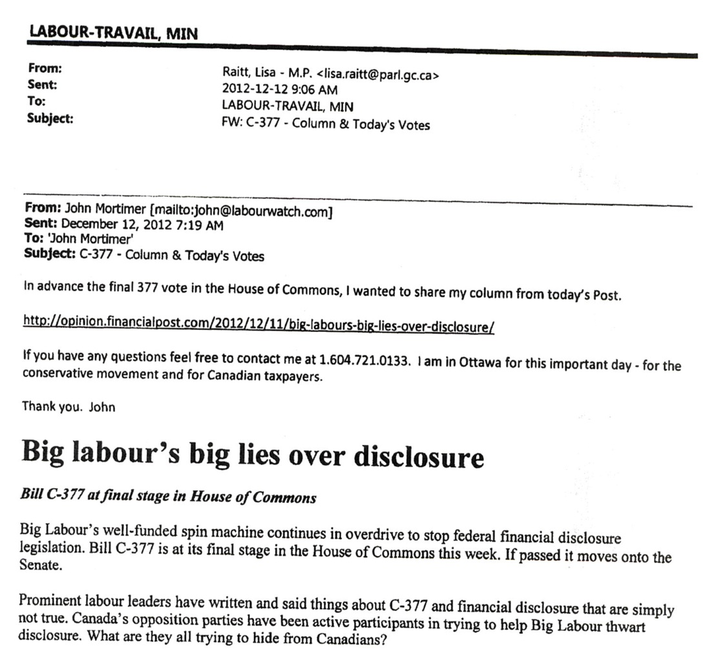
For this Important Day…

Slide 36
C-377 in the Senate
December 13, 2012 (First reading)
May 7, 2013 (Second reading)
June 13, 2013 (Senate Committee on Banking, Trade, and Commerce)
June 26, 2013 (Third reading)
  22 Conservative Senators abstain or vote with Liberal Senators
  Amended bill returns to the Commons
Before Oct. 2011 | Oct. to Nov. 2011 | Dec. 2011 to Dec. 2012 | Dec. 2012 to June 2013 | June 2013 to Present

Slide 37
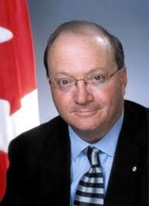
Resistance in the Red Chamber
“This bill before us, whatever may have
been its laudable transparency goals,
is really — through drafting sins of omission
and commission — an expression of statutory
contempt for the working men and women
in our trade unions and for the trade unions
themselves and their right under federal and provincial law to organize. It is divisive and unproductive.”
- Hugh Segal, Hansard, 17 June 2013.
Before Oct. 2011 | Oct. to Nov. 2011 | Dec. 2011 to Dec. 2012 | Dec. 2012 to June 2013 | June 2013 to Present

Slide 38
C-377 on Hold?
“[C-377] is a private member’s bill. Our priorities are government bills.”
- Conservative Senator Claude Carigan and Government Leader in the Senate Tom Korski, “A bill is quietly buried”, Blacklock’s, 28 February 2014.
“I guess we’ll wait and see as to whether the government decides to make this a priority in the next period of time when House reconvenes in September. [...] Everything we’re hearing from Senators, this is not a priority and they’re not likely to deal with it.”
– Hassan Yussuff, President, CLC, interview with authors (July 2014).
Before Oct. 2011 | Oct. to Nov. 2011 | Dec. 2011 to Dec. 2012 | Dec. 2012 to June 2013 | June 2013 to Present

Slide 39
The 2011 LabourWatch-Nanos Poll Revisited
Two problems with this poll:
Priming effect and social desirability
Suppressing results
Before Oct. 2011 | Oct. to Nov. 2011 | Dec. 2011 to Dec. 2012 | Dec. 2012 to June 2013 | June 2013 to Present

Slide 40
The 2011 LabourWatch-Nanos Poll Revisited
Before Oct. 2011 | Oct. to Nov. 2011 | Dec. 2011 to Dec. 2012 | Dec. 2012 to June 2013 | June 2013 to Present

Slide 41
The 2011 LabourWatch-Nanos Poll Revisited
In fact, respondents were also provided with the following information and question (Question 20):
“As you may know, public and private sector unions do not pay taxes, the union dues of unionized employees of the private and public sectors are tax deductible and their strike pay is not taxable. In addition, tax payers pay the wages of civil servants and, therefore, fund their union dues. Please tell me whether you COMPLETELY AGREE, SOMEWHAT AGREE, SOMEWHAT DISAGREE OR COMPLETELY DISAGREE with the following statement:
It should be mandatory for unions from both the private and public sectors to publicly disclose detailed financial information on a regular basis.”
Source: Source: State of the Unions 2011 - LabourWatch – August 2011 (updated version, date not known), p. 36. Available at: http://www.nanosresearch.com/library/polls/2011StateoftheUnions.pdf
Before Oct. 2011 | Oct. to Nov. 2011 | Dec. 2011 to Dec. 2012 | Dec. 2012 to June 2013 | June 2013 to Present

Slide 42
The 2011 LabourWatch-Nanos Poll Revisited
The information prefacing the statement on the previous slide did not appear in the original Labour Watch-Nanos report that was released on September 5, 2011.
Before Oct. 2011 | Oct. to Nov. 2011 | Dec. 2011 to Dec. 2012 | Dec. 2012 to June 2013 | June 2013 to Present

Slide 43
The 2011 LabourWatch-Nanos Poll Revisited
On page 3 of the original report, it is stated that:
“Canadians were divided on whether the Canadian public or just union Members/unionized employees should have access to unions’ financial information.”
Didn’t 83% of respondents support public disclosure?
What is the basis for the claim about divided opinion?
Before Oct. 2011 | Oct. to Nov. 2011 | Dec. 2011 to Dec. 2012 | Dec. 2012 to June 2013 | June 2013 to Present

Slide 44
The 2011 LabourWatch-Nanos Poll Revisited
In fact, respondents were provided with the following information and question (Question 18):
“In the United States, detailed disclosure of specific financial information is required by all unions to be made available to anyone who wants it. In Canada, some provinces do not have any requirements for unions to disclose financial information, while others require limited financial information be provided to union members only upon request.”
Continued on the next slide...
Source: State of the Unions 2011 - LabourWatch – August 2011 (updated version, October 29, 2011), p. 30. Available at: http://www.nanosresearch.com/library/polls/2011StateoftheUnions.pdf
Before Oct. 2011 | Oct. to Nov. 2011 | Dec. 2011 to Dec. 2012 | Dec. 2012 to June 2013 | June 2013 to Present

Slide 45
The 2011 LabourWatch-Nanos Poll Revisited
In your opinion, who should have access to the financial
information of unions operating in Canada?
Unionized employees ................................... 1
Actual union members only ......................... 2
The Canadian public (i.e. everyone) ............. 3
No one .......................................................... 4
The information on the previous slide,
the above question and related results did not appear in the original LabourWatch-Nanos report.
Before Oct. 2011 | Oct. to Nov. 2011 | Dec. 2011 to Dec. 2012 | Dec. 2012 to June 2013 | June 2013 to Present

Slide 46
The 2011 LabourWatch-Nanos Poll Revisited
In late-October 2011, Nik Nanos added an appendix to the original report that explains why the responses to the previous question were suppressed.
The following reasons were provided:
Response categories were not mutually exclusive (e.g., no all of the above choice)
Vagueness of the term “access”
Before Oct. 2011 | Oct. to Nov. 2011 | Dec. 2011 to Dec. 2012 | Dec. 2012 to June 2013 | June 2013 to Present

Slide 47
The 2011 LabourWatch-Nanos Poll Revisited
The two questions are “horrendously biased.” “This is not the kind of polling that people in our discipline should be doing. Clearly it’s being done by an advocacy group that’s got a particular perspective on the world and an axe to grind, and they’re using the poll not to illuminate their understanding of public opinion but as a PR [public relations] tool.”
- Allan Gregg cited in Peter O’Neil, “Poll cited by Tory MP in union disclosure fight under review by polling standards groups” The Vancouver Sun. 5 July 2013.
Before Oct. 2011 | Oct. to Nov. 2011 | Dec. 2011 to Dec. 2012 | Dec. 2012 to June 2013 | June 2013 to Present

Slide 48
The 2011 LabourWatch-Nanos Poll Revisited
“It turns out that the Nanos poll and the question you used was actually cooked. The unions have pointed out to you that in fact the question in the Nanos poll, the preamble to it, simply would not stand up to any kind of scrutiny. Your 83 per cent is, like many things, smoke and mirrors.”
- Senator Campbell to Russ Hiebert, Hansard, “Proceedings of the Standing Senate Committee on Banking, Trade and Commerce”, 22 May 2013.
Before Oct. 2011 | Oct. to Nov. 2011 | Dec. 2011 to Dec. 2012 | Dec. 2012 to June 2013 | June 2013 to Present

Slide 49
The 2011 LabourWatch-Nanos Poll Revisited
In August 2012, the Canadian Labour Congress filed a complaint against Nanos Research to the Marketing Research and Intelligence Association (MRIA)
Before Oct. 2011 | Oct. to Nov. 2011 | Dec. 2011 to Dec. 2012 | Dec. 2012 to June 2013 | June 2013 to Present

Slide 50

Marketing Research and Intelligence Association
MRIA is composed of over 1,800 members working in the fields of market intelligence, survey research, data mining, and knowledge management.
Formed in 2004, the MRIA is responsible for regulating and promoting the professional and business interests of its membership.
Nik Nanos was party to the Association’s founding, served as the organization’s president between 2006 and 2007, and was elected MRIA Fellow in 2010.
Before Oct. 2011 | Oct. to Nov. 2011 | Dec. 2011 to Dec. 2012 | Dec. 2012 to June 2013 | June 2013 to Present

Slide 51
MRIA Code of Conduct and Good Practice
- Members commit to ensure “that research is conducted appropriately at all times, matching the appropriate tools to objectives and avoiding research which is inadequate, misleading or inaccurate.”
- Researchers “must not knowingly allow the dissemination of conclusions from a marketing research project which are not adequately supported by the data.” “Members must not provide, or allow without protest interpretations of the research that are inconsistent with the data.”
MRIA, Code of conduct and good practice for members of the Marketing Research and Intelligence Association (MRIA 2007), http://mria-arim.ca/about-mria/standards/code-of-conduct-for-members.
Before Oct. 2011 | Oct. to Nov. 2011 | Dec. 2011 to Dec. 2012 | Dec. 2012 to June 2013 | June 2013 to Present

Slide 52
The MRIA’s Decision in the CLC-Nanos Case
“I am advised by the Complaint Panel that it found no evidence of a violation of the Code by the Respondent [Nanos Research], nor evidence of any act or omission by the Respondent that has brought discredit to the industry/profession.” […] “The Complaint Panel found that the reporting of the two questions in issue, specifically the omission of question 18 from the report and the reporting of question 20 without the preamble, allowed potentially biased information to be reported by LabourWatch. However, despite the lack of clarity in reporting observed, the Complaint Panel concluded the Code had not been violated.”
- Ruth Corbin, “RE: Complaint of professional misconduct regarding Nanos Research’s conduct and reporting of LabourWatch Poll”, 30 September 2013.
Before Oct. 2011 | Oct. to Nov. 2011 | Dec. 2011 to Dec. 2012 | Dec. 2012 to June 2013 | June 2013 to Present

Slide 53
A Different Story Inside the
MRIA Complaint Process
The MRIA Complaint Panel recommended:
1. Nanos should inform the LabourWatch, and copy the CLC and MRIA, that the question 20 must only be reported within the complete context of the question including the preamble.
2. The complete preamble for question 20 must be used whenever Nanos refers to the question or the 83% figure and Nanos should acknowledge to the CLC in writing the importance of including the preamble when talking about the results.
Before Oct. 2011 | Oct. to Nov. 2011 | Dec. 2011 to Dec. 2012 | Dec. 2012 to June 2013 | June 2013 to Present

Slide 54
A Different Story Inside the
MRIA Complaint Process
3. Nanos should also inform LabourWatch that the full questionnaire, including the omitted question, needs to replace the questionnaire that was on the LabourWatch website. (see slide 56)
4. Nanos should also seek permission from LabourWatch to release the results of question 18. These results should be communicated to the CLC by letter (with a copy to MRIA).
- Information provided to the authors by an anonymous source.
Before Oct. 2011 | Oct. to Nov. 2011 | Dec. 2011 to Dec. 2012 | Dec. 2012 to June 2013 | June 2013 to Present

Slide 55
A Different Story Inside the
MRIA Complaint Process
LabourWatch requests standing in the complaint process after the July 2013 story in the Vancouver Sun.
MRIA complaint process is like a “kangaroo court” (Georgetti).
LabourWatch refuses to comply with the MRIA Complaint Panel’s recommendations (communicated via Nanos Research).
Before Oct. 2011 | Oct. to Nov. 2011 | Dec. 2011 to Dec. 2012 | Dec. 2012 to June 2013 | June 2013 to Present

Slide 56
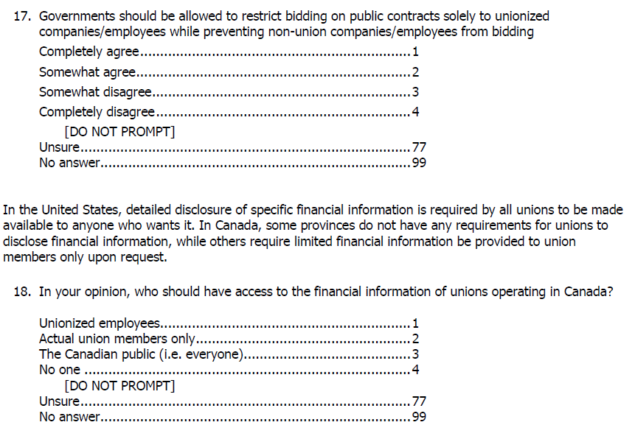
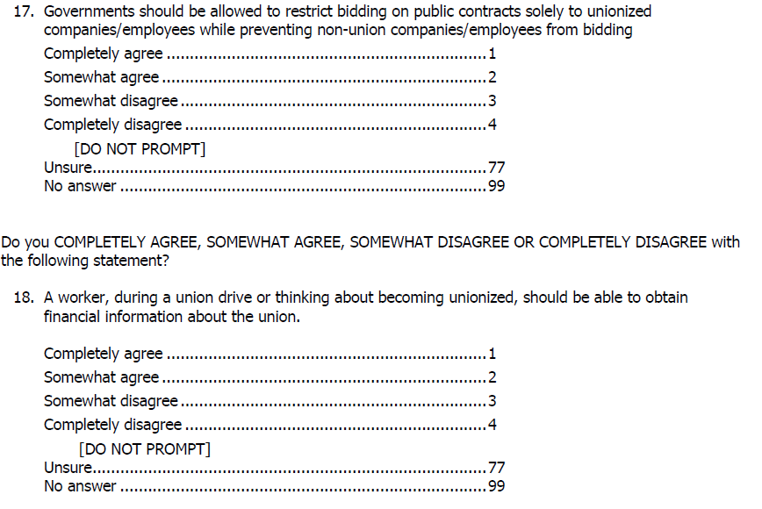
LabourWatch Removes Survey Question
Nanos Research Version LabourWatch Version
LW removes Q18 in NR survey

Slide 57
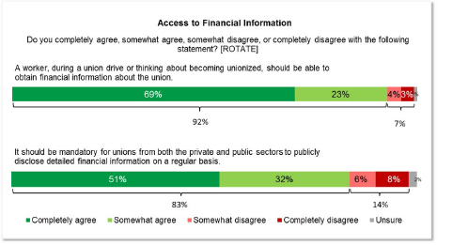
Is Nanos Research in Compliance with the MRIA Decision?
Priming information still does not appear in NR report

Slide 58
A New LabourWatch Poll
- During the MRIA complaint process LabourWatch sponsors a poll testing the effect of priming.
- Results showed that 83% (without priming) and 85% (with priming) agreed that unions should be required to “publicly disclose detailed financial information on a regular basis.”
- LabourWatch-Leger, State of the Unions 2013.

Slide 59
Public Willingness to Endorse Transparency
“My guess would be that if you put that general question without the preamble you’d still get a pretty one-sidedly pro-disclosure response. You’re asking people to endorse openness. Well who’s against that? [This] against the background of a generally negative cultural response to the union movement. […] I suspect that if you asked exactly the same question about corporations it may not be 83% but I bet you it would be pretty one-sided.”
- Richard Johnston, Canada Research Chair in Public Opinion, Elections, and Representation, interview by authors.

Slide 60
Hiebert Touts New LabourWatch Poll
“The South-Surrey-White Rock-Cloverdale MP said the poll of 1,400 working Canadians – conducted in July and August for what he termed the “non-partisan” Canadian LabourWatch Association – shows “a broad public consensus” on the need for “financial transparency” by labour unions.”
- Alex Browne, “Hiebert touts poll support,” Peace Arch News, 4 November 2013.

Slide 61
C-377 Makes a Comeback
Russ Hiebert’s renewed optimism for C-377
“Some of those Senators have moved on.”
“Opportunity for some education to occur and the circumstances have changed.”
- Russ Hiebert, CPAC, 23 September 2014.
Before Oct. 2011 | Oct. to Nov. 2011 | Dec. 2011 to Dec. 2012 | Dec. 2012 to June 2013 | June 2013 to Present

Slide 62
C-377 Makes a Comeback with
Polling as a Cover Story
“An October 2013 Leger survey found that more than 80 per cent of current or formerly unionized Canadians and 83 per cent of all working Canadians want unions to publicly disclose their finances. The union bosses who oppose this bill so fiercely want to hide their spending, and not just from Canadians but from their own members.”
- Senator Bob Runciman, Hansard, 25 September 2014.
Before Oct. 2011 | Oct. to Nov. 2011 | Dec. 2011 to Dec. 2012 | Dec. 2012 to June 2013 | June 2013 to Present

Slide 63
Harper Government Gives Full Support to C-377
“Mr. Speaker, our government believes that Canadians and workers should have the right to know where their mandatory dues are being spent. That is something that all Canadians are asking for. That is why we continue to support Bill C-377, a reasonable bill to increase union transparency.
[C-377] was introduced in December 2011 and has spent two years in the Senate. It is time to get it out of the Senate. We believe that we need to move the bill ahead.”
- Kevin Sorensen, Hansard, Minister of State for Finance, 22 September 2014.
Before Oct. 2011 | Oct. to Nov. 2011 | Dec. 2011 to Dec. 2012 | Dec. 2012 to June 2013 | June 2013 to Present

Slide 64
Segal’s Response to Renewed Interest in C-377
“Use of unprecedented time allocation on private members' bills like 377 would justifiably produce a fire storm. […] 377 was badly drafted legislation, flawed, unconstitutional and technically incompetent when it was amended last time. Unamended, it has not now become perfect simply because one senator retired to do other things."
- Hugh Segal, The Canadian Press. 21 September 2014.
Before Oct. 2011 | Oct. to Nov. 2011 | Dec. 2011 to Dec. 2012 | Dec. 2012 to June 2013 | June 2013 to Present

Slide 65
Analysis of C-377 in the Context of the Conservative Anti-Union Agenda
Convergence of anti-union forces and legislation (C-525, essential services, etc.)
Influence of the PMO
Whipping a private members bill
Dissent within the Conservative ranks
Ideology over public policy

Slide 66
Final Thoughts on the Polling Industry
“MRIA has not learned from this particular situation” and it “needs to probably have a fairly serious discussion about whether it can regulate or can enforce its code of conduct when so many pollsters do work for advocacy organizations that have particular agendas.”
Maureen Prebinski, interview with authors.

Slide 67
Final Thoughts on the Polling Industry
“If the media did a better job examining the type of research that came out of pollsters, maybe pollsters would feel that they were being held to a higher standard, and to be quite frank, usually you can get away with just about anything, because the media can be sloppy when it comes to taking on pollsters.”
- David Northrup, Director of the Institute for Social Research at York University, interview with authors.

Slide 68
Contact information:
Dr. Andrew Stevens
andrew.stevens@uregina.ca
306-585-4711
Dr. Sean Tucker
sean.tucker@uregina.ca
306-337-3244

