Slide 1
Programming and Problem Solving
Open Textbook Project
Dr. Alireza Manashty, Department of Computer Science

Slide 2
Acknowledgement
Isaac Mulolani
AVP Academic
Nilgün Önder
Department of Computer Science
Dr. David Gerhard
Dean, Faculty of Science
Dr. Douglas Farenick

Slide 3
Motivation
CS 110
Programming and Problem Solving
1000+ students annually
Mandatory textbook
Introduction to Programming
Online only (4th Edition), $95 per student
$95000+ annually
Most students end up not buying

Slide 4
Textbook Project
Started in August 2020
Goals
Accessible to everyone
Interactive environment
Tailored to current U of R CS 110
Plan
Create open online interactive exercises right in the textbook
Collaborate with department and instructors

Slide 5
Current Progress
Initial draft is created
Published the first few chapters online
Includes interactive exercises
Used Repl.it for now
Working on an alternate server`
Published on GitHub
Free hosting
Ongoing update from community

Slide 6
Platform
We tried several platforms and languages
GitBook, PressbooksEDU
AsciiDoc, LaTeX, Word
We ended up writing it in MD (Markdown)
The only way to incorporate interactive web exercises
Convertible to all other formats
Publishable in GitHub and most open-source formats
Decoupled from rendering

Slide 7
Markdown

Slide 8
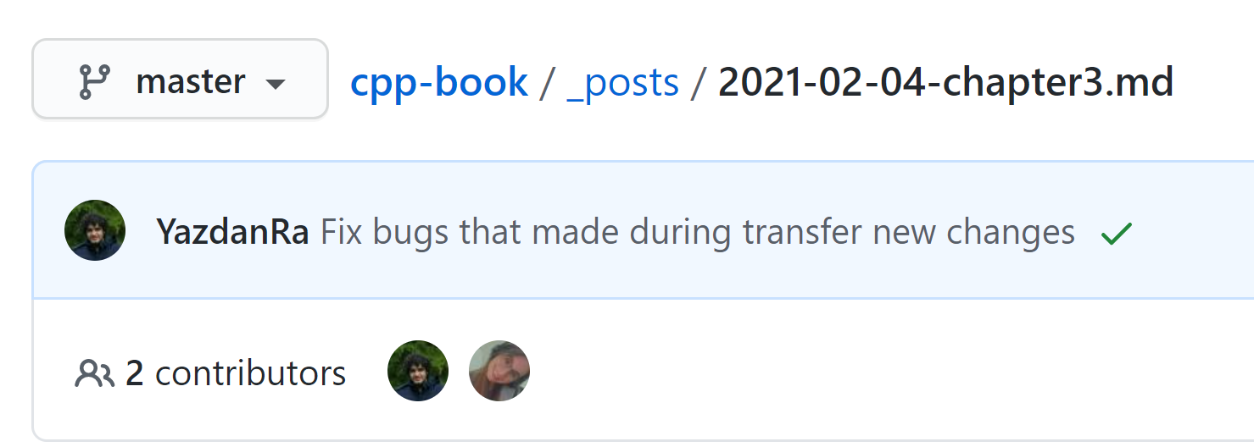
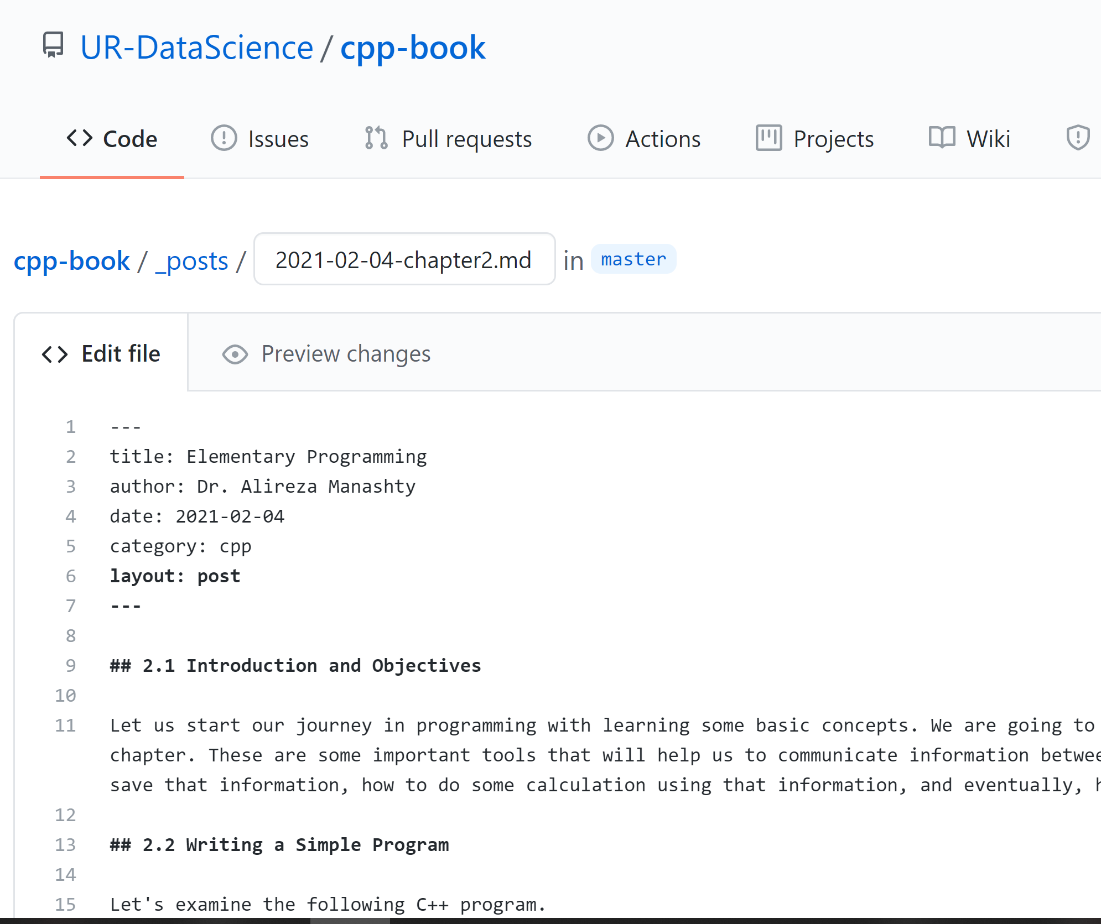
Community Development

Slide 9
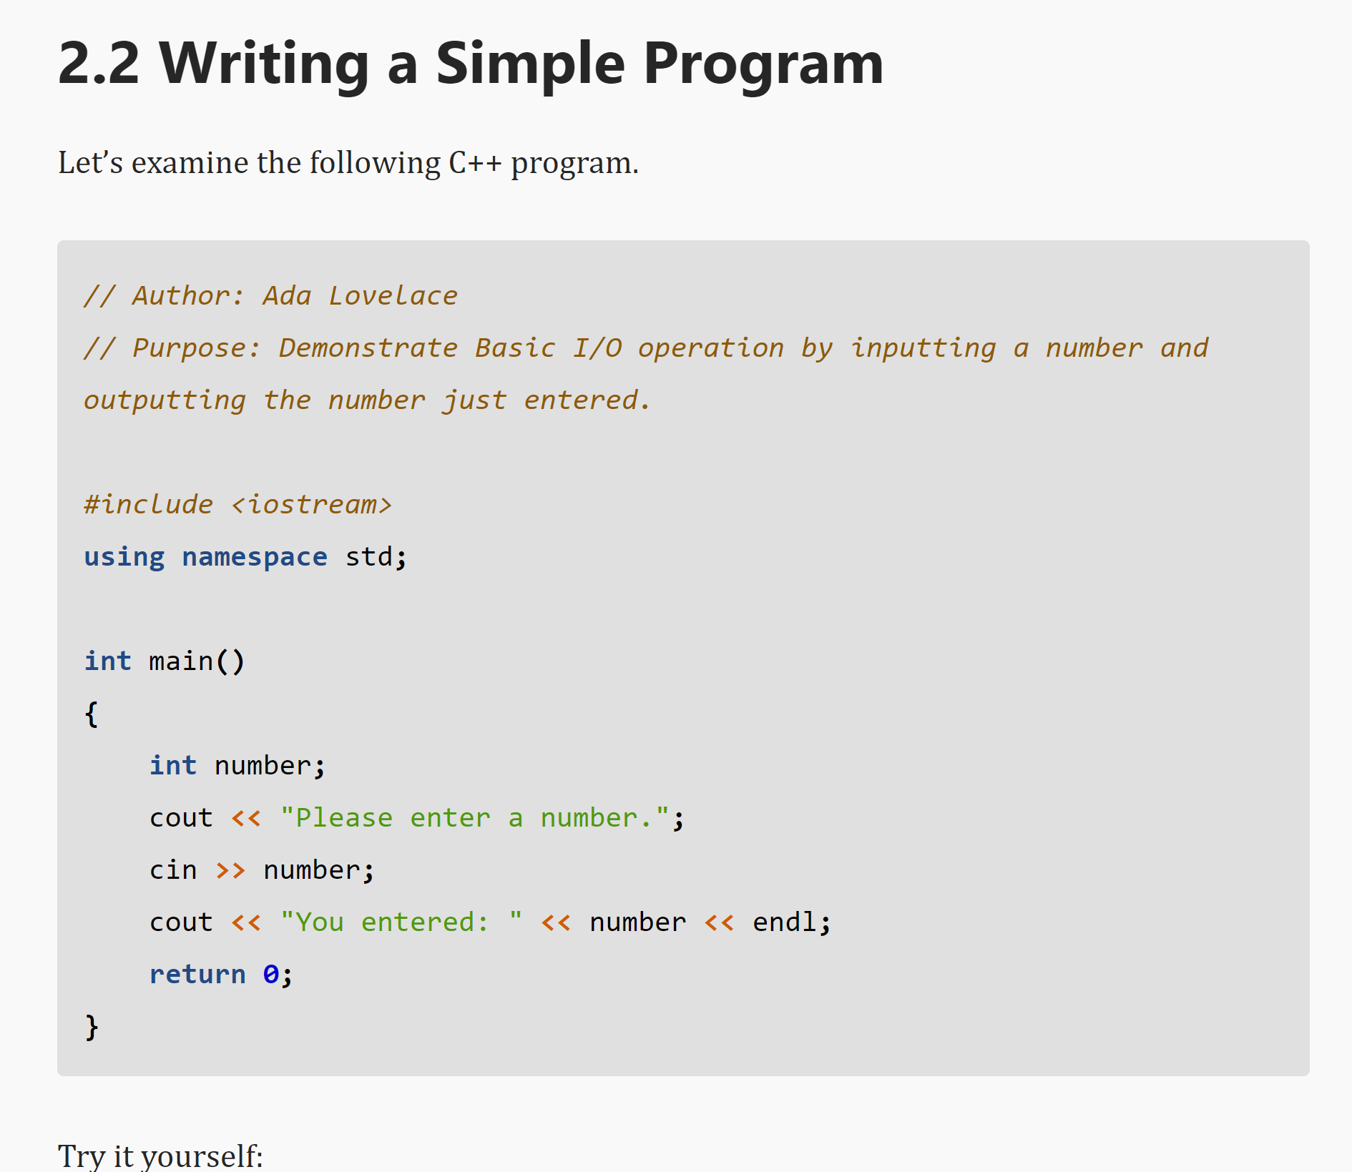
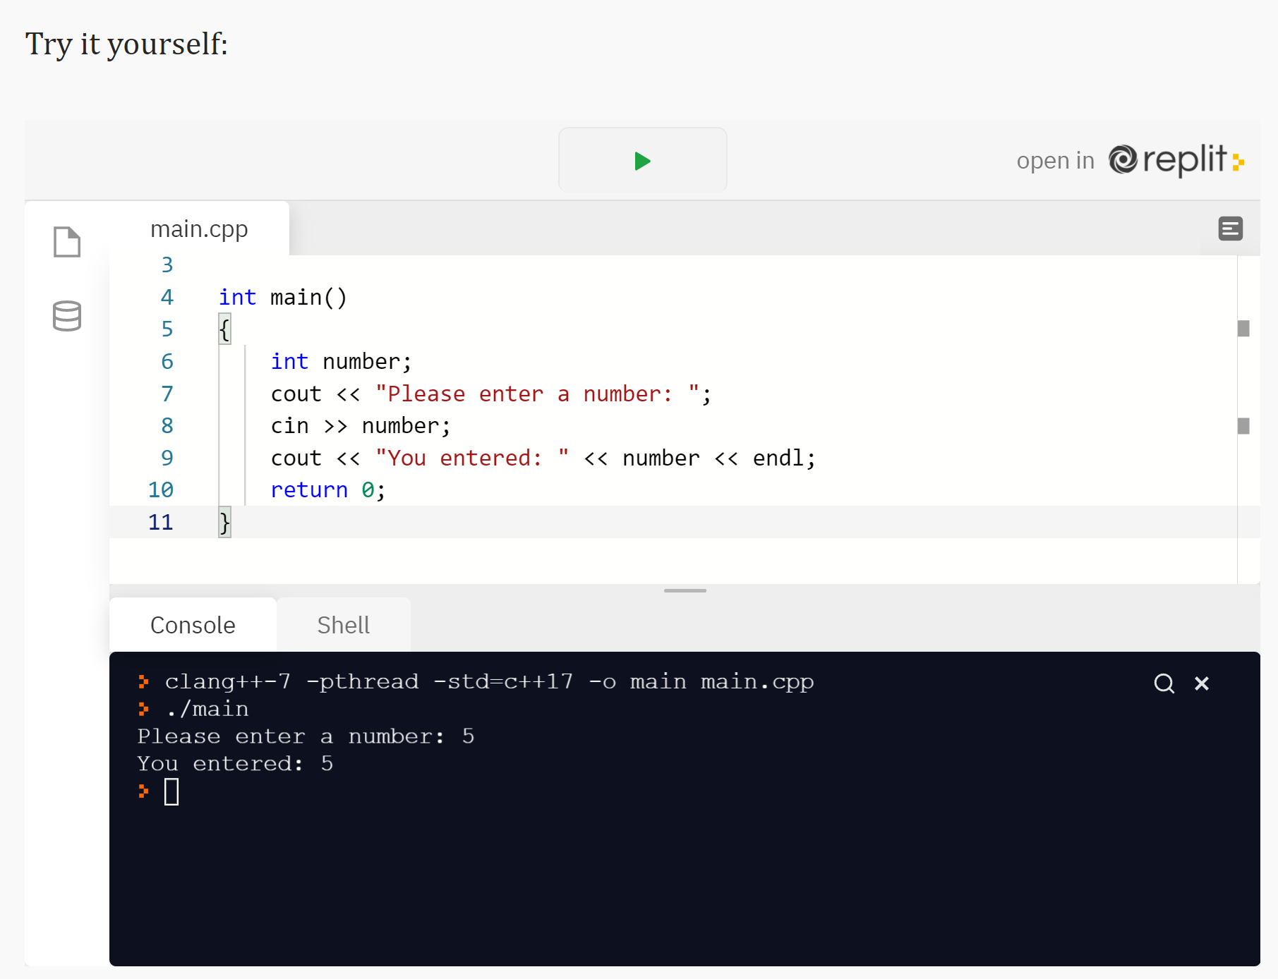
Interactivity Example

Slide 10
Open Access Online Resources

Slide 11
Next steps
Review/Update the textbook chapter by chapter
Provide it to students as a resource to review
Creating more online exercises
Creating a server for online exercises
Coderunner
Slides, cover, graphics, etc.

