Slide 1
H5P
H5P’s goal is to enable everyone to create better content faster. To empower everyone to create, share, and reuse interactive content.

Slide 2
What is an H5P?
It is HTML5 content that can add interactions and creativity into…
browsers (websites)
learning management systems (UR Courses)
and publishing platforms (Pressbooks).
H5Ps help to ease copyright issues, technical roadblocks, and compatibility between platforms.
Website. https://h5p.org/

Slide 3
Many Options
Over 30 content types, with varying levels of difficulty
Course presentations, image hotspots, collage, dialog cards, drag the words, image juxtaposition, image sequencing, branching scenarios, and the list goes on!
Examples of all can be found here - https://h5p.org/content-types-and-applications

Slide 4
Why Use?
Easy way to add visuals to text
Keeps engagement while reading
Another way to present content
Test knowledge or learner self-check
Customize the learning experience
Can add low stakes tasks for learners

Slide 5
Considerations
Con - Limited features
Pro – Easy to use, device responsive, user results are stored, UR Courses reuse
Ideas
A tough concept that may need extra visuals
Case studies – a way to set apart from regular text
Need a break from text?
Don’t be overwhelmed! Start easy.

Slide 6
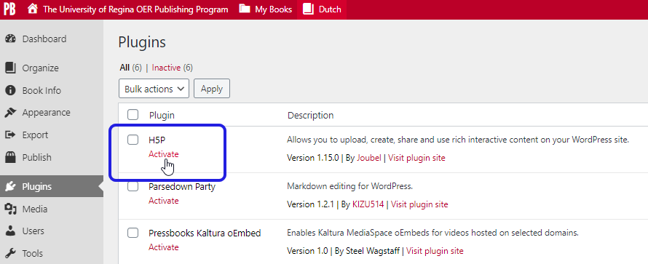
Pressbooks Integration
Activate the H5P plugin - Add H5P integration

Slide 7
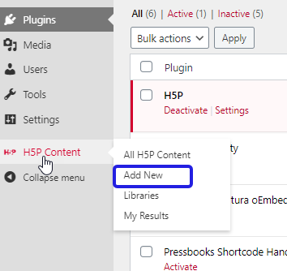
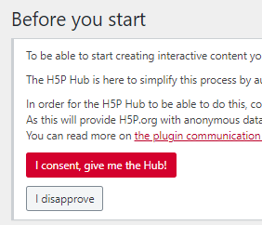
Pressbooks Integration - Add
Add New, give consent to use H5P Hub, and then choose ‘Get’

Slide 8
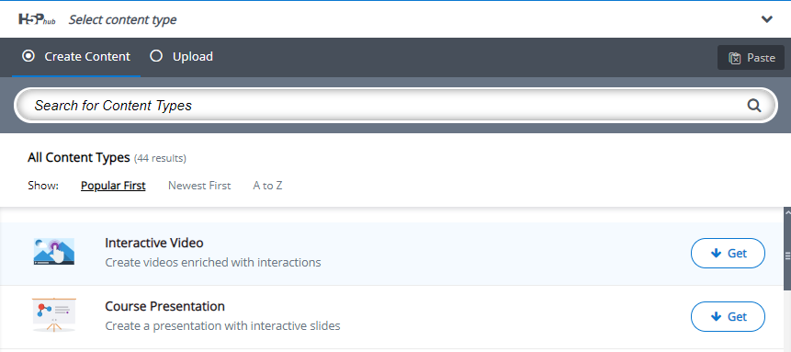
Pressbooks Integration - Get
Install the content type by clicking on “Get” and following the steps indicated (if necessary).
Enter the information for your quiz/activity etc.

Slide 9
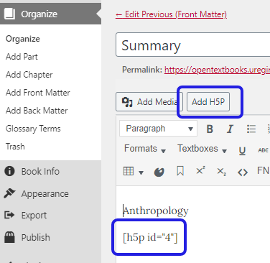
Pressbooks Integration - Use
The will now be an H5P side menu option.
All create H5Ps will appear in that location
They can be used on any page!

Slide 10
Let’s Try It

Slide 11
U of R Examples - Ideas

Slide 12
Seeking Help
The Basics - https://h5p.org/documentation/for-authors/the-basics
Tutorials - https://h5p.org/documentation/for-authors/tutorials

Slide 13
Questions?

