Slide 1
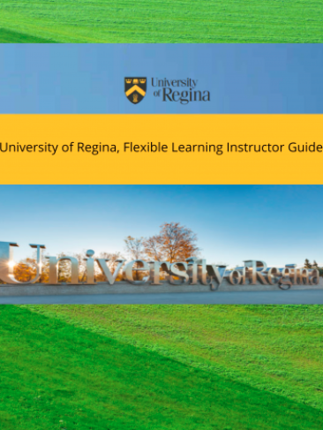
PRESSBOOKS: Flexible Learning Division Instructor Guide
Gilbert Niyoyita

Slide 2
Motivation for PB Instructor Guide
Frequent change in information
Version control & Content Management
PREVIOUS ISSUES with pdfs
More Formarting effort + time
Frequent Need to repost pdfs

Slide 3
Our Plan
Possible to add interactive content (H5P plug-in) and more procedures are being moved to PB
Continuous update and archive content
Guide sent to every instructor
Permanent link**

Slide 4
Use Cases
Easy to get information approved and Edited 1. Dates
2. CBS and departments info approvals
3.Instant updates
4. Content Feedback
5. Accessing the guide
HR now sends an updated version all the time.
No need to repost when content is updated(Permanent link)
Able to archive content that’s not useful during pandemic.

Slide 5
PB Recommendation
Inability to add sub-chapters is a minor issue observed that could help us create knowledge management content with main and sub chapters.

Slide 6
Overall
It has helped save time and been able to archive and publish content from one place with the least people and effort. Users: Instructors/departments can also download pdfs if they like.

Slide 7
?
gilbert.niyoyita@uregina.ca
Notes:
Incase they want out contact info, do not leave it on this slide during questions though.

