Slide 1
Universal Design for Learning in Post Secondary Education
UDL 101
Jenn de Lugt

Slide 2
Why Universal Design for Learning (UDL)?
Reduces barriers making learning more accessible to all students
Benefits students with and without disabilities through:
Greater opportunities for engagement
Improved motivation through autonomy and choice
By broadly benefitting all students, the proactive approach of UDL reduces/eliminates the need for individualized accommodations

Slide 3
Three Principals of UDL
Engagement
(motivating)
The why of learning
Multiple ways of motivating
Provide choice
Increases interest and effort
Representation
(teaching)
The what of learning
Multiple ways of teaching/presenting
Action and Expression
(assessing)
The how of learning
Multiple ways of assessing what students have learned
Choice in how learning demonstrated

Slide 4
UDL in Post Secondary Education
Practical Applications

Slide 5
Consider Student Diversity
A student with ADHD (Attention Deficit Hyperactivity Disorder) may thrive on spontaneity and excitement, whereas a student on the Autism Spectrum may prefer predictability and routine
Some students may prefer the social aspect of group work, whereas others would prefer to work alone or in pairs
Students with Specific Learning Disorders (or Learning Disabilities) may require more time to complete a task, or may require Assistive Technology (e.g. text-to-speech, or speech-to-text programs)
A student with mobility (or auditory, or vison) challenges may need a certain physical layout of the classroom in order for it to be accessible for them
Students with mental health challenges may require attendance and deadline flexibility/leniency

Slide 6
Considering Student Diversity
This is not to suggest something different is needed for each of these students…
And, it is not to suggest outcome expectations should be lowered…
By implementing UDL proactively and preemptively, the need for specific individualized accommodations are reduced (or eliminated)
Think of UDL as “setting the stage” for the diversity you are likely to have in any given classroom
Consider UDL as framework within which all students can best learn, regardless of ability—consider UDL as providing learning opportunities available to all students

Slide 7
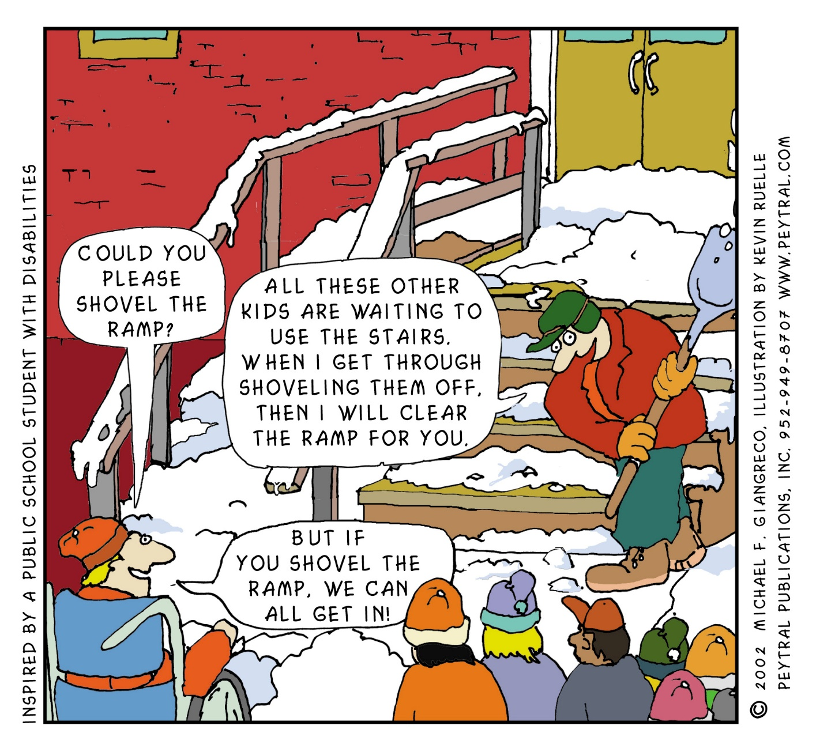
Think of a Ramp…

Slide 8
UDL in Post Secondary Education
Practical Applications

Slide 9
Post Secondary Education
Post Secondary Education typically includes:
Lectures
Group discussions/activities
Lab work
Field work
Assessment

Slide 10
Course Lectures
Generally lectures consist of:
Lectures (the human element—expression)
Readings (the background information)
PowerPoints (a visual summary)
UDL considerations for lectures:
Alternate/combined modalities e.g. sign language, visual and verbal
Recorded (audio and/or video)—posted online, available to all
More accessible through time and place
Can be stopped and started, replayed, etc.
Note taker (or takers)—posted online, available to all
Can be assigned and included as part of the participation mark

Slide 11
Course Lectures
UDL considerations for readings:
Textbooks (and other readings) are inherently inflexible
Many texts have a digital format (more accessible)
Consider web alternatives
UDL considerations for PowerPoint:
Use Microsoft “accessible templates”
Ensures slide design, colours, contrast, and fonts are accessible for all
Minimize written content and use visuals where possible
Enhances lecture structure and engagement (visual and verbal)

Slide 12
Group Discussions/Activities
UDL considerations for group discussions:
Often used to augment/supplement lectures
For some students (e.g. students with Specific Learning Disorders) the interactive nature of smaller groups helps them engage (in contrast to their passivity in lectures)
More engaging and relevant
More confident in participating and contributing
Encourages complex, active, group-based construction of knowledge rather than simple delivery of information
Applying UDL principles, students can:
Choose topic
Choose groups (size and constitution)
Choose role (note taker, presenter, etc.)

Slide 13
UDL in the Sciences
UDL considerations for the sciences:
Provide written and verbal instruction, as well as visual aids
Allow extra time for setup and task completion
Use plastic instead of glass where possible
Make lab signs and equipment labels in large print, with high contrast
Maintain wide aisles for accessibility
Install a mirror above a demonstration area
Provide gloves for handling wet or slippery items
Use lever controls instead of knobs where possible
Make sure fields sites are accessible

Slide 14
Assessment Practices
UDL considerations for assessment practices:
The ways in which students are required to demonstrate and express what they have learned
Multiple means of expression should be provided
Examples:
Quizzes/tests/exams (consider removing or being flexible with time constraints)
Projects
Portfolios
Research papers
Blog/website production
Creative work (e.g. a play, video, novel, or comic strip)
Consider being flexible with timelines and allowing re-writes

Slide 15
General UDL Considerations
Use multiple sensory modalities where possible
e.g. subtitles/captioning with videos and Zoom video conferencing
Provide text alternatives for all audio/video e.g. incorporate sounds and descriptions of visual content (e.g. “spinning and laughing”)
Use peer mentoring—bi-directional benefits
Create accessible documents
Use logical sequencing with headings
Use tables/charts where possible
Use effective images to support concepts
Use an online “accessibility checker”

Slide 16
General UDL Considerations
Choice in topic and presentation/assessment mode, encourages student:
Engagement
Motivation
Autonomy—encourages the learner to be strategic and goal-directed
Leads to:
Greater buy-in and school satisfaction
Better attendance
Improved grades and better learning
Improved self concept and future career opportunities

