Slide 1
Navigating the Learning Agreement
Guidance on completing a learning plan for Social Work Practicum I and II
Content developed by Kelsey Lagus, MSW RSW (SK) and Erin Beckwell MSW RSW (SK)

Slide 2
Why use learning contracts or agreements?
formalizes explicitly what student needs to work towards and how they will be evaluated
should reflect professional behaviours and responsibilities specific to the setting
opportunity to link abstract to concrete
Source: Bogo, M. & Vayda, E. (2000). The practice of field instruction in Social Work: Theory and process (2nd Ed).

Slide 3
Why use learning contracts or agreements?
developing accurate, measurable goals is a foundational skill of social work practice
developing, practicing, and strengthening foundational skills in social work will improve your competence and confidence as a social worker
Your learning agreement might not always be important to your Field Instructor, and that's okay.

Slide 4
Learning Goals
Answer the question, "What do I want to learn?"
Usually begins with, "To...."
to gain an understanding of...
to gain the skills to...
to increase my knowledge of...
to apply social work theory in...

Slide 5
Learning Activities
Answer the question, "How will I achieve my goal?"
Usually begins with an action verb:
observe
participate
communicate
attend
complete
debrief
read

Slide 6
Learning Outcomes
Answer the question, “How will I (and others) know I’ve achieved my goal?”
Includes methods (who will be assessing progress and how it will be assessed) and criteria for assessing the outcome (concrete, observable, measurable behaviours or actions).
often begin with "I will be able to...", "I will have knowledge of...", or "I will demonstrate..."

Slide 7
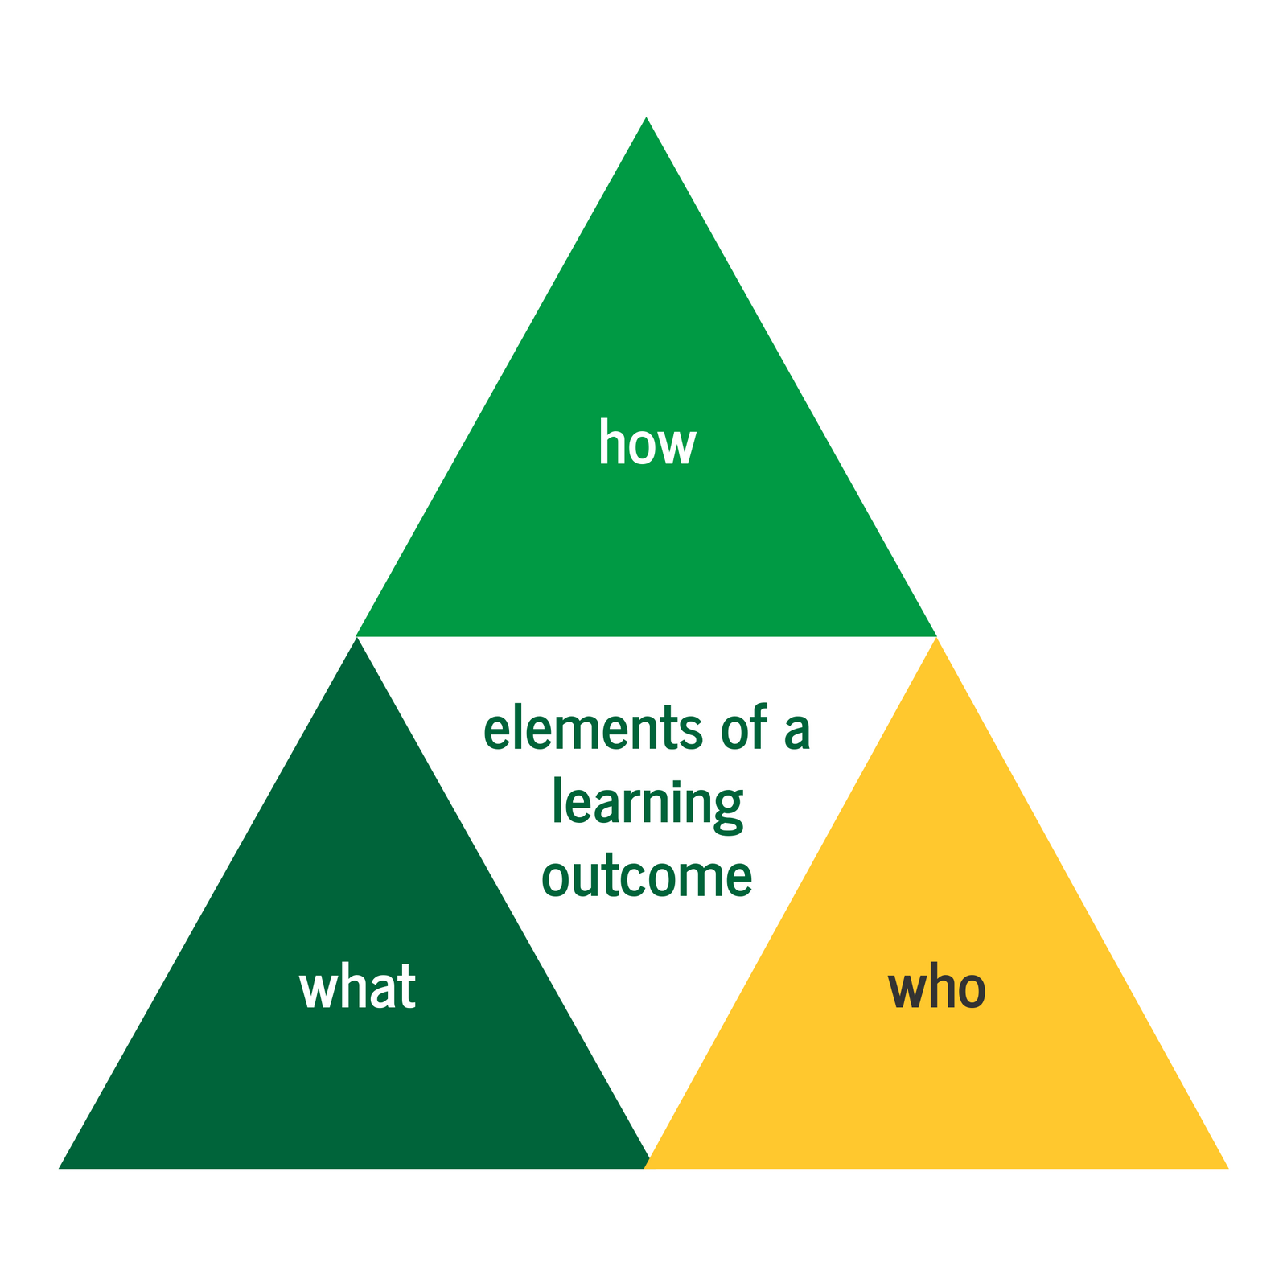

Slide 8
Elements of a Learning Outcome: What
the task or action you will demonstrate or complete
detail is important here - be as specific as possible about what you will be doing to ensurer your outcome is descriptive, clear, and measurable
example: I will be able to complete individual case notes following client sessions.

Slide 9
Elements of a Learning Outcome: How
descriptive words that provide criteria for assessing the task or action you will demonstrate or complete
the 'how' of your learning outcome will be added through adjectives (descriptive words)
example: I will consistently be able to complete accurate, timely, and ethical individual case notes following client sessions.

Slide 10
Elements of a Learning Outcome: Who
who will be assessing the learning outcome
the 'how' of your learning outcome will usually be a person (including yourself) or a group of people
example: I will consistently be able to complete accurate, timely, and ethical individual case notes following client sessions, as assessed by my Field Instructor.

Slide 11
Complete Learning Goals include What, How, and Who
Example: Student will accurately describe agency policy.
Complete Example: Student will accurately (how) describe agency policy (what) as assessed by field instructor (who).
Includes how (accurately) and what (agency policy), but not who.
Example: Student will describe agency policy, as assessed by their Field Instructor.
Better Example: Student will accurately describe agency policy on client referral process and service mandate as assessed by the field instructor in weekly supervision.
Includes what (agency policy) and who (Field Instructor) , but not how.
Strengthened by the addition of specific details, making the outcome clearer and more measurable.

Slide 12
Learning Agreement Checklist
Semester/term is listed accurately (eg. Fall 2023).
Document is reviewed for spelling, grammar, and clarity.
There are a minimum of 2 learning goals for each competency.
For each goal, there are learning activities and outcomes (number may vary).
Learning outcomes are complete - include how, what, and who.
Financial arrangements section completed by Field Instructor.
Document is signed by both student and Field Instructor.

